Slide 1

IoT – Visible Things Platform
Budapest – Mobil Weekend
András Lajos – Field Application Engineer

Slide 2
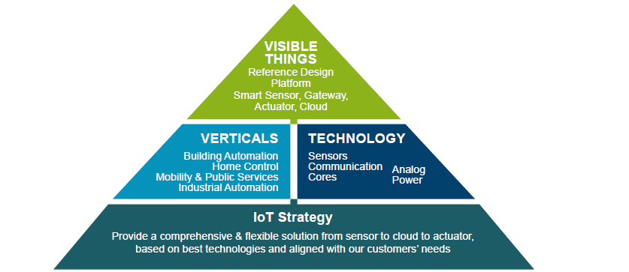
Avnet Silica IoT strategy

Slide 3
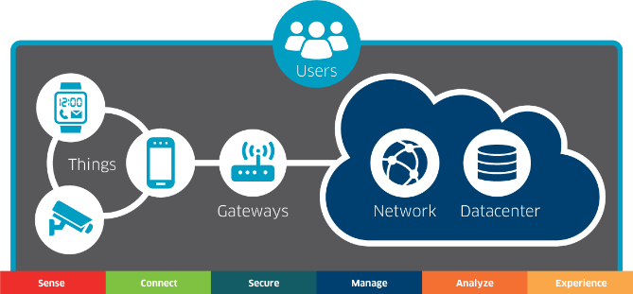


„Edge-to-Enterprise“
EDGE
ENTERPRISE
Sense
Connect
Secure
Manage
Analyze
Experience
AVNET Silica
AVNET Technology Solutions
Markets, Solutions, Services, Ecosystem

Slide 4
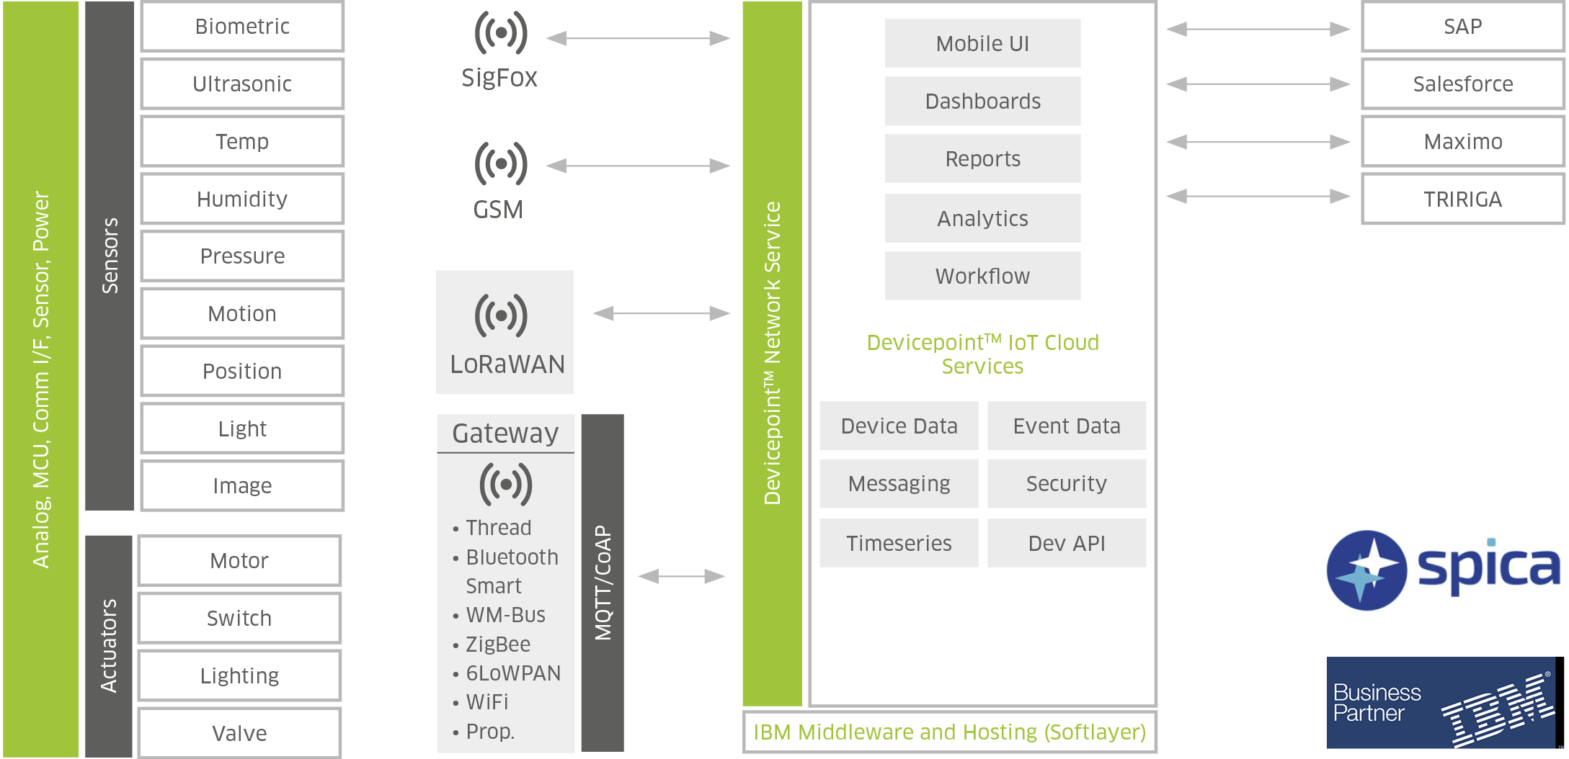
Scope of the Visible Things Platform

Slide 5


What is Visible Things ?
A evaluation and development platform for Edge-to-Enterprise IoT projects
It delivers hardware and embedded software to connect smart sensors right through to the cloud and enterprise software
1
2
Aligned with customer applications
8
3
Hardware consists of a Gateway board, Sensor boards and connectivity PMODs
Sensor
Based on best-in-class technology regarding function, cost, long term availability
Gateway
It‘s a ‚living‘ solution, we will regularly be adding features
7
4
6
5
The perfect tool, providing a ‚out-of-the-box‘ experience. Setup in 1 minute.
Lowest power & most flexible Edge-to-Enterprise platform, managed in the cloud

Slide 6


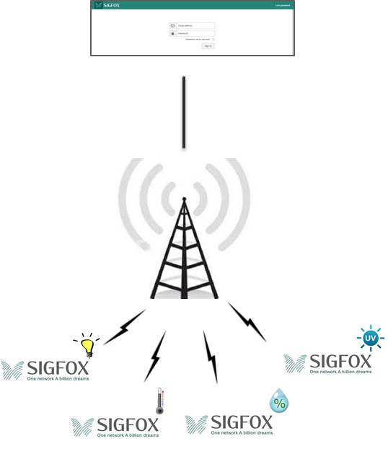
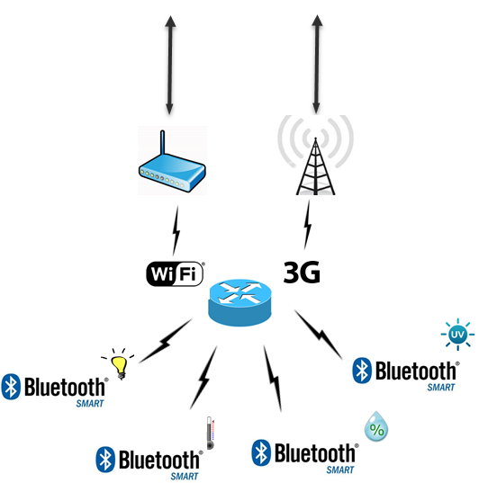
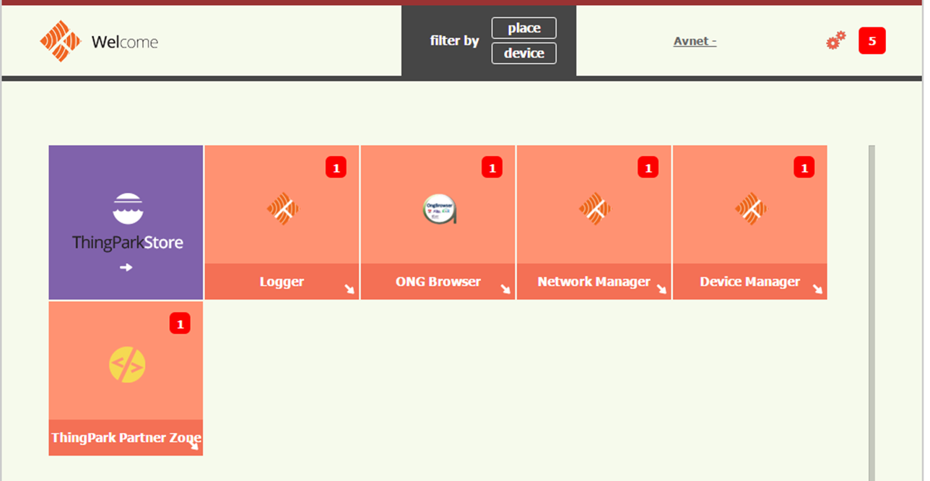







Visible Things 1.0 – Overview
Application
Server

Slide 7
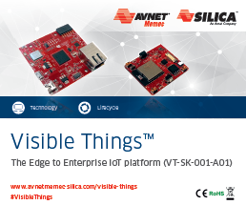
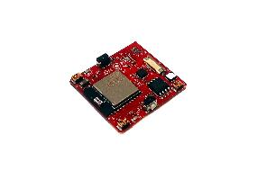
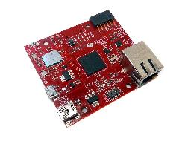



Visible Things Starter Kit
Gateway
Smart Sensor
Bluetooth Smart
WiFi
Cellular
Cloud Services

Slide 8








Visible Things – Protocol Support
  Sigfox™
  LoRa™
  Thread
  BT Smart
  WIFI
  IPv4 and IPv6
  3G/4G
  Huawei/Neul

Slide 9
SW / cloud – which solution ?
Which SW/cloud is/will be supported?
Microsoft Azure
Oracle
Spica
IBM BlueMix
Avnet Market Place

Slide 10
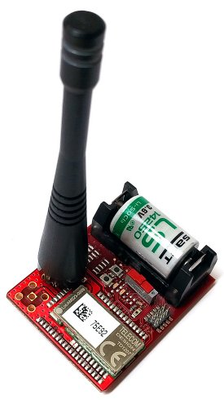
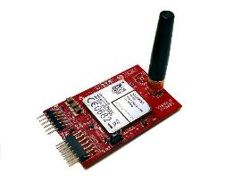
Sensor nodes
SIGFOX
LoRaWAN
GSM
Simplecell
České Radiokomunikace
O / T / V

Slide 11
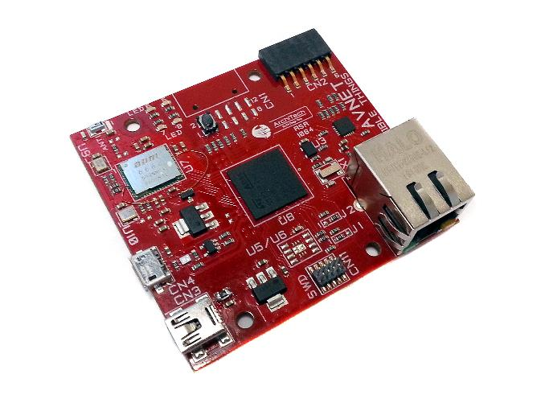
The Gateway
PMOD ( I2C )
Expansion (opt.)
PMOD ( UART/SPI )
Expansion
Button & LEDs
LAN8742
Ethernet PHY
Microchip
APM6668
WiFi – Smart module
APM Communication
USB Master
STM32F746
ARM Cortex M7
ST
USB Slave & Power input
Debug Header
TO136
Trust controller
Trusted Object

Slide 12

The BLE Sensor
Si1143
Light/Proximity sensor
Silicon Labs
Expansion connector
TO136
Trust controller
Trusted Object
MPU9250
Motion sensor
Invensesne
Push Buttons
Si7021
Temperature/Humidity
Silicon Labs
BGM111
Bluetooth Smart module
Silicon Labs
MX25R3225
Low power memory
Macronix
LEDs
IR LEDs
CR2032 Battery powered

Slide 13

GSM PMODs (3G/4G)
MU709S-2
or
MU909
GSM modem module
Huawei
SLM97CIFX8000
Embedded SIM
Morpho
PMOD ( UART )
Expansion
SIM connector
PMOD ( I2C )
Expansion
SIM selector Jumper

Slide 14
Sigfox Sensor node
MKL26Z128
Low power microntroller
NXP
Li ½ AA Battery
TO136
Trust controller
Trusted Object
WakeUp & Reset Buttons
Switch &
Led
FXOS8700
Motion sensor
NXP
SFH3710
Light sensor
OSRAM
TD1207
SigFox module
Telecom Design
Debug Interface

Slide 15
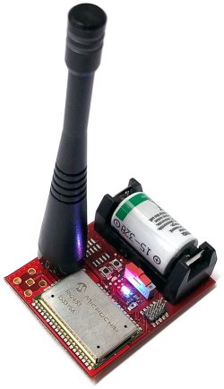
LoRaWAN Sensor node
MKL26Z128
Low power microntroller
NXP
Li ½ AA Battery
TO136
Trust controller
Trusted Object
Switch
Led
FXOS8700
Motion sensor
NXP
SFH3710
Light sensor
OSRAM
RN2483
LoRaWAN module
Microchip
Debug Interface

Slide 16
Deliverables – Kits and Order codes
SAP Part Number | Description | Comments
BAEVT-SK-001-A01 | Visible Things Starter Kit | Bluetooth Smart Sensor board Gateway Board Antenna Mini USB cable
BAEVT-SS-001-A01 | Bluetooth Smart Sensor | To connect additional sensors onto the gateway board
BAEVT-SS-002-A01 | LoRaWAN Smart Sensor | Includes sensor board together with antenna.
BAEVT-SS-003-A01 | SIGFOX Smart Sensor | Includes sensor board together with antenna.
BAEPMOD-COM-019-A01 | GSM PMOD | Based on Huawei MU709S2
BAEPMOD-COM-001-A01 | SIGFOX MODEM UART PMOD | Based on Telecom Design TD1207
BAEPMOD-COM-002-A01 | APP. CUST. SIGFOX MODEM UART | Based on Telecom Design TD1208
BAEPMOD-COM-003-A01 | LORA MODEM UART PMOD | Based on LoRaWAN MCHP RN2483
Available
199€
Starter Kit
Comms Options
59€
80€
Sensor node/ PMOD

Slide 17























































AVNET Silica Product Portfolio

Slide 18

Thank you.

